Slide 1
TBI on a BBB Chip to study the effects of Curcumin
Fabiha Firoz, Tanima Dey, Shivangi Sarkar

Slide 2
Introduction
Traumatic Brain Injury
Nondegenerative and Noncongenital insult to the brain caused by external force
Occurs from violent blow or jolt to the brain
permanent / temporary impairment of cognitive, physical, and psychosocial functions
Notes:
Traumatic Brain Injury isn't a condition present during birth nor is it a disease where there is a gradual negative progression of function over a period of time, instead it is a condition where an external force can cause permanent/ temporary damage such as motor impairment, cognitive deficits, language and comprehension difficulties
Common violent blow/ jolt which can cause TBI are motor vehicle accidents, falls, and sports injuries.

Slide 3
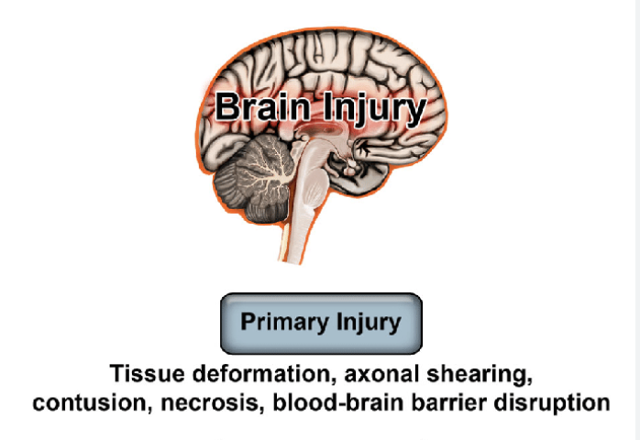
Primary Injury
Injuries that occur immediately after the incident
Sudden or profound injury
Caused by direct mechanical forces exerted on the brain
Notes:
There are two type of Brain Injury.
One of them is the primary injury.
the primary injury refers to the initial physical damage to the brain tissue that occurs at the moment of impact or injury. This damage is typically caused by the direct mechanical forces exerted on the brain, such as
the rapid acceleration or deceleration of the head,
penetration of the skull by an object,
or the impact of the brain against the inner surface of the skull.
Primary injuries may come in form of contusions, tearing of nerve fibers , hemorrhage or skull fractures

Slide 4
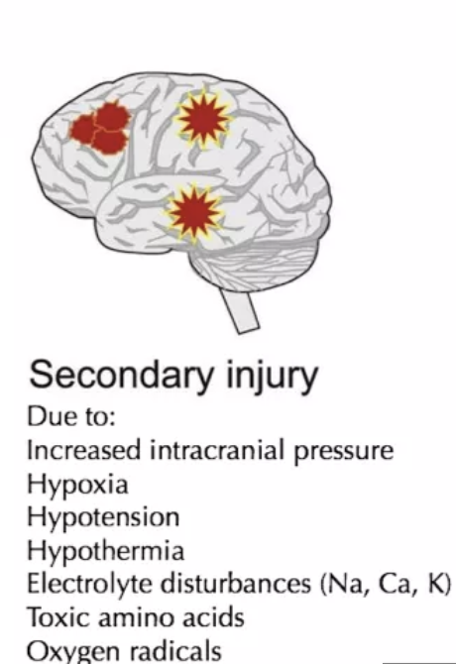
Secondary Injury
Hours to days after injury primary injury
Reactive process after the initial head trauma
series of steps of cellular, chemical, tissue, or blood vessel changes which may cause destruction of brain tissue.
  Chemical, molecular, and inflammatory effects take place in the brain
Notes:
Secondary injury refers to the
cascade of biochemical, cellular, and molecular events that occur in The hours to days following the primary insult
Unlike primary injury, secondary injury processes can cause tissue damage and contribute to neurological deficits over time. Which includes inflammation, excitotoxicity, oxidative stress, mitochondrial dysfunction, blood-brain barrier disruption, and cell death pathways.

Slide 5
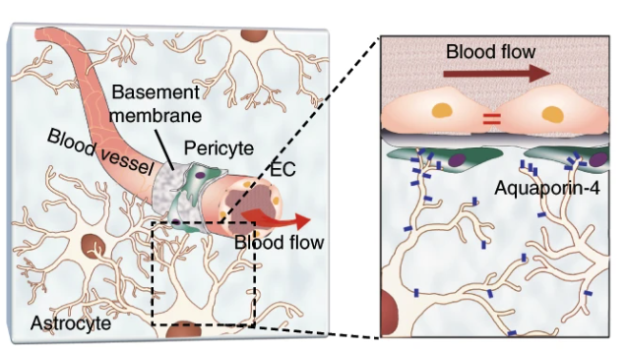



Introduction: Blood Brain Barrier (BBB)
selective semi-permeable membrane between the blood and the interstitium of the brain
Consists of…
Endothelial cells
Pericytes
astrocytes
https://doi.org/10.1038/s41467-019-13896-7
Notes:
For our device we will be focusing on recreating the blood brain barrier.
As mentioned in journal club previously, the cells that allow the BBB to be highly selective are the endothelial cells, pericytes and astrocytes.
The endothelial cells help with the inner lining of the blood vessels. They also help regulate the exchange of nutrients, oxygen and waste products.
The Pericytes are known to wrap around the endothelial cells and help contribute to the regulation of blood flow and involved in angiogenesis, they also modulate immune response in the central nervous system.
The astrocytes are known to provide metabolic and structural support to the neurons in brain and spinal cord. They regulate the extracellular environment, maintain ion balance such as the aquaporin 4, maintain and help with formation of the blood brain barrier
It is formed by tightly packed endothelial cells lining the blood vessels in the brain, along with surrounding cells such as astrocytes and pericytes

Slide 6
Introduction: purpose of the BBB
Selective permeability
Neuroprotection
Brain homeostasis
Neurotransmitter levels
Notes:
What are the crucial roles of the Blood Brain Barrie
Selective Permeability: The BBB selectively allows certain substances to pass from the bloodstream into the brain while blocking others. This helps maintain the brain's internal environment and protects it from harmful agents circulating in the blood.
Neuroprotection: By preventing the entry of toxins, pathogens, and large molecules into the brain, the BBB serves as a protective barrier for delicate brain tissue.
Regulation of Brain Homeostasis: The BBB regulates the balance of ions, nutrients, and other essential molecules within the brain, ensuring optimal conditions for neuronal function.
Control of Neurotransmitter Levels: It regulates the passage of neurotransmitters and other signaling molecules between the bloodstream and the brain, modulating neuronal communication.

Slide 7

More detailed view on of TBI effects on BBB
Steps of the destruction of BBB
Macrophages are activated
Cytokines are released
Abundance of adhesion molecules→ creation of binding sites
Notes:
This video shows the effect of traumatic Brain Injury in the Blood Brain Barrier
The macrophages are activated which are inflammatory responses. It releases cytokines which kill neurons and causes brain damage. As you can see in the video the vessels are broken
The cytokines are able to to do this by increasing adhesion molecule binding in the surface of endothelial cells. Some examples of cytokines which are released are TNF which tumor necrosis factor- alpha, IL1 B (interleukin 1 beta), interleukin 6 and interleukin 8.
The binding causes more immune cells to pass through the membrane which increases the vessel permeability and compromise the structural integrity.

Slide 8
Introduction: TBI effects on BBB
Shearing forces leads to breaches in the BBB
Inflammatory responses can disrupt the tight junctions of endothelial cells
Oxidative stress can impair the BBB integrity and function
  Occludin and claudin
Changes in neurotransmitter level can affect the BBB permeability
Decreased TEER
Increased permeability
Notes:
The physical disruption is caused by the mechanical forces involved from the TBI and it can cause shearing forces ultimately breaching the Blood Brain Barrier.
The inflammatory responses cause various different molecules activating like the cytokines and that eventually leads to increase in BBB permeability due to the inflammatory cascade and influx of inflammatory molecules.
Oxidative stress can affect the BBB in various different ways such as damaging the endothelial cells which can cause the BBB to be weaker since endothelial cells are a big part of tightly lining the vessels, it can disrupt function of junction proteins like occludin and claudin and it can promote inflammation
Neurotransmitter Imbalance: Changes in neurotransmitter levels following TBI can affect the regulation of BBB permeability, further compromising its integrity.

Slide 9
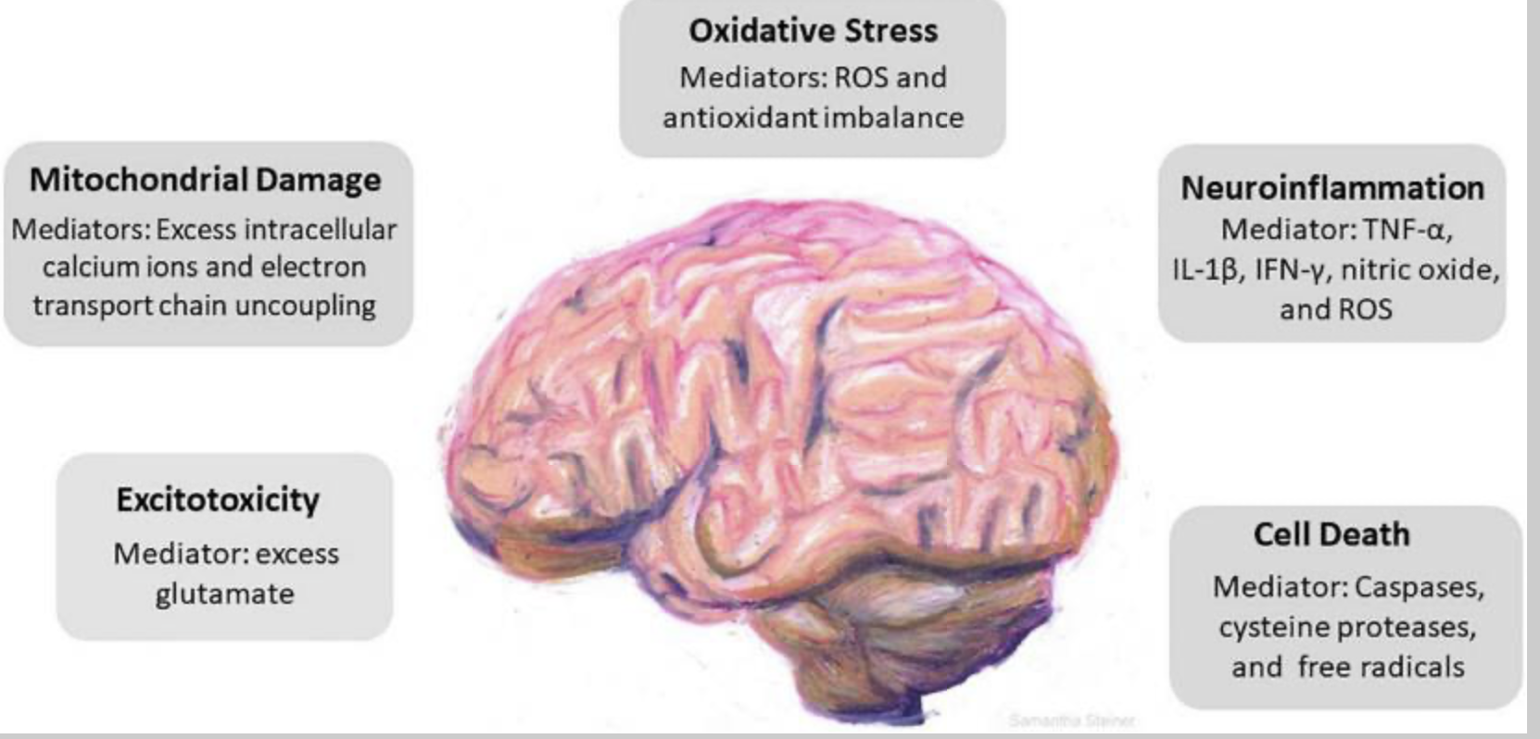
TBI: Chemical components
Excitotoxicity: immediate intractable excessive release of excitatory neurotransmitters .
Oxidative stress: Imbalance in ROS and antioxidant levels
Neuroinflammation : Release of cytokines such asTNF-α, interleukin (IL)-1β, and interferon (IFN)-γ .
Cell death: Secondary damage after head trauma ultimately leads to neuronal cell death.
Notes:
https://www.ncbi.nlm.nih.gov/pmc/articles/PMC9995859/#:~:text=Cascade%20of%20cellular%20events%20driven,each%20pathological%20event%20is%20identified.
Cascade of cellular events driven by traumatic brain injury (TBI). TBI incites a series of responses that include excitotoxicity, mitochondrial damage, oxidative stress, neuroinflammation, and cell death. Key mediators in each pathological event is identified
Glutamate can overstimulate neuron receptors which can lead to excitotoxicity
Excess calcium ions leads to mitochondrial damage and it can affect atp production. ATP production decreasing means cells cannot perform its task and it may die so this can affect endothelial cells and cause the BBB to be more permeable.
Oxidative stress is cause by reactive oxygen species and antioxidant imbalance

Slide 10
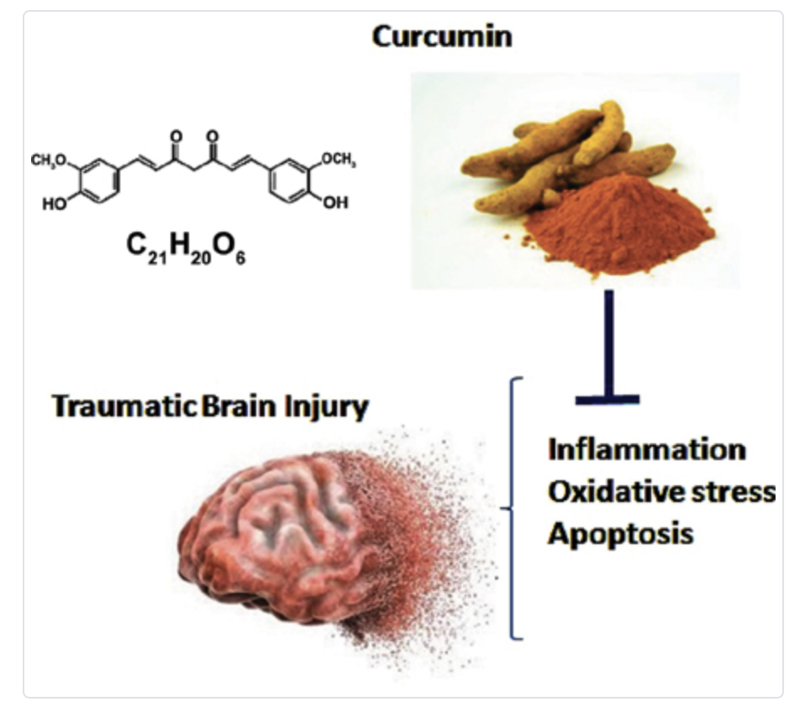
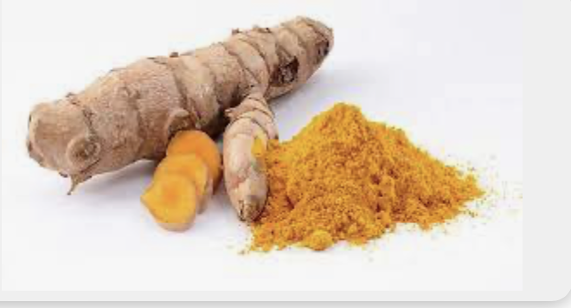
Curcumin treatment
Curcumin is a dietary antioxidant found in turmeric, known for its potential health benefits.
Experimental studies have shown that curcumin can help improve outcomes in TBI by reducing damage caused by oxidative stress.
Curcumin shows promise as a therapeutic agent for TBI due to its antioxidant, anti-inflammatory, and neuroprotective properties.
It acts on multiple pathways involved in TBI pathology, including oxidative stress, inflammation, and neuronal survival.
Further research is needed to fully understand the mechanisms of curcumin's effects and its potential for clinical use in TBI treatment.
Notes:
Decrease oxidative stress and increase BDNF levels.
Improve synaptic plasticity and cognitive function.
Reduce brain edema (swelling) and inflammation.
Decrease the size of brain lesions and improve neurological deficits.
Modulate inflammatory pathways involved in TBI.
Activate pathways that protect against oxidative damage.
Inhibit apoptotic cell death (cell death caused by injury) and inflammation.
Enhance autophagy (a cellular process that removes damaged components) and neuronal survival.

Slide 11
Current Methods
In Vivo Testing of Curcumin
Study Design | Independent Variable | Control | Treatment Duration | Results
Male Rats | Cur (10 mg/kg, i.p.); Cur (20 mg/kg, i.p.); Cur (30 mg/kg, i.p.); Cur (50 mg/kg, i.p.); | Vehicle (Saline) | 5 weeks | • ↓ Levels of NLRP3, IL-1β, IL-6, IL-18, TNF-α • ↑ BDNF/TrkB and PI3K/Akt signaling pathways
Notes:
Write about in vivo
This study had 5 rat models in each group and it was tested for 5 weeks
Molecules which are associated with inflammation such as NLRP3, IL-1β, IL-6, IL-18, TNF-α have shown a decrease whereas BDNF/TrkB and PI3K/Akt have shown an increase which are signalling pathways. Increase in this will cause neuronal survival, growth and plasticity allowing the brain to function and prevent neurodegeneration.
*if asked why saline is used as a control say
Saline solution is simply a mixture of salt (usually sodium chloride) dissolved in water, which closely mimics the electrolyte balance of bodily fluids.
If question is asked talk about in vivo
In vitro studies
Circumin decreases post TBI Inflamation
100 mg/kg Curcumin showed anti inflammatory responses
Curcumin downregulated TLR4/MyD88/NF-κB signaling pathway
TLR4/MyD88/NF-κB signaling pathway. This pathway is involved in inflammation and immune response. By inhibiting this pathway, curcumin exhibits anti-inflammatory and immunomodulatory effects which can help maintain the BBB structural integrity
TLR4: Toll-like receptor 4 - This is a type of receptor protein found on the surface of immune cells. Toll-like receptors (TLRs) play a crucial role in recognizing pathogens like bacteria and viruses.
MyD88: Myeloid differentiation primary response 88 - This is an adaptor protein that is recruited to Toll-like receptors upon activation. MyD88 serves as a link between the receptor and downstream signaling molecules.
NF-κB: Nuclear factor kappa-light-chain-enhancer of activated B cells - This is a transcription factor that regulates the expression of genes involved in inflammation, immune response, cell survival, and other cellular processes. Activation of NF-κB is a key step in the inflammatory response.
https://www.sciencedirect.com/science/article/pii/S0753332222010101?ref=pdf_download&fr=RR-2&rr=878ab0bf1a4fa718

Slide 12
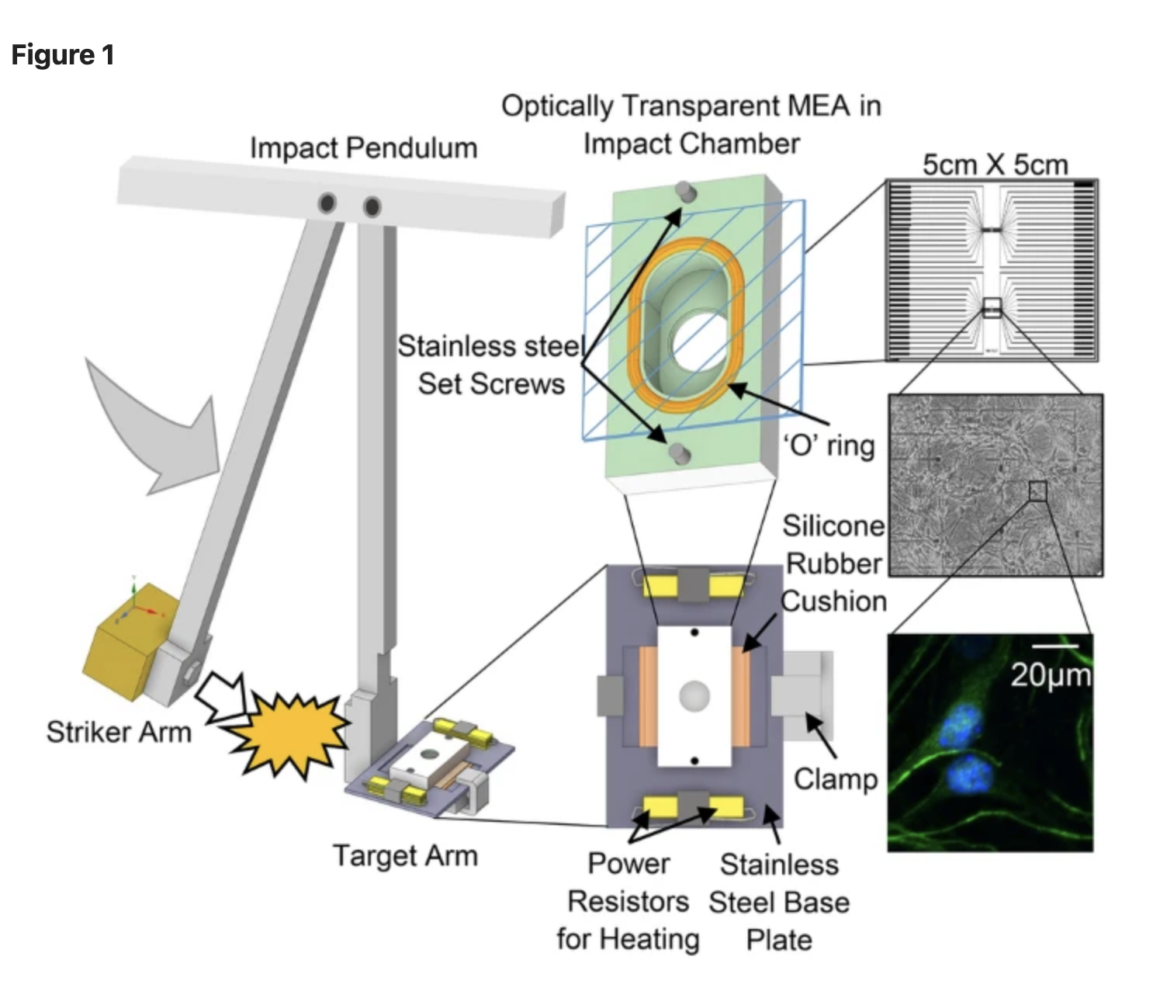
Current methods
Primary Neuron Culture
Primary Neuron Cultures were taken from frontal cortex tissues taken from embryos of mice
Placed into microelectrode array after inserted with couple of serum
Pendulum Model
Impact pendulum swings causing striker arm to hit the target arm
https://doi.org/10.1038/s41598-022-14937-w
These impact pendulum tests reveal that force dependent factors can cause an increase in inflammation and oxidative stress
Notes:
Purdue
The frontal cortex tissues were taken from embryos from mice and treated with horse serum, fetal bovine solution and seeded into microelectrode array.
So over here they are trying to mimic the first injury occured from the TBI and it showed that it increases inflammation because of the increase in endogenous accrolin which basically reactive aldehyde and it can cause oxidative stress as well as activating inflammatory pathways
Maturation period

Slide 13
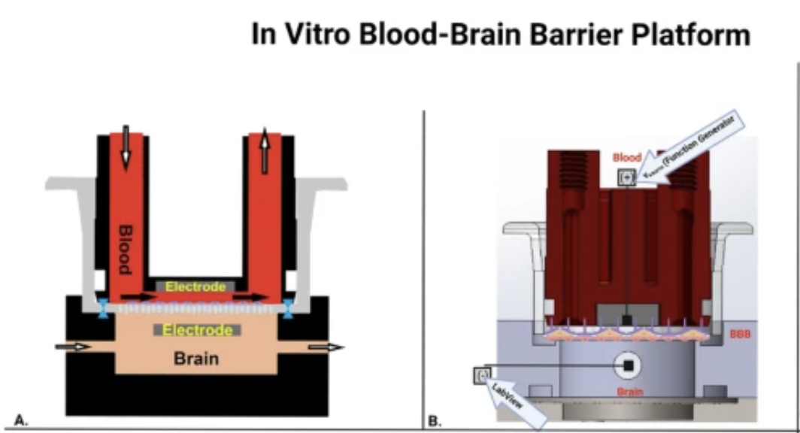
Current methods: Mimicking TBI on Blood Brain Barrier In Vitro
Wall Shear Stress
In order to create a shear stress equivalent EGM plus media was perfused through a peristaltic pump
TNF -α
Study effects of permeability and teer
OGD/R
Oxygen glucose depleted environment
Glucose free DMEM allows for OGD conditioning- hypoxic environment
Dextran Permeability Assay Test
Permeability coefficient calculated based on concentration of dextran, observation period and surface area
Notes:
One of the current methods uses a peristaltic pump to to perfuse the blood in the platform. The purpose of this pump was to mimic the shear stress equivalent to the physiological conditions.
The Tnf was also was treated into the study to measure the changes in TEER of the BBB and this was done by using the embedded aluminum electrode for measuring the electrical properties of the cultures.
In the OGD conditioning treatment, the cells are placed in stressful situation such as low glucose and low oxygen to mimic the oxidative stress that occurs during a TBI. the TEER was measure when the cells where in hypoxic environments and after recovery as well meaning when the cells returned to their normal conditions. In the results it was shown that before recovery TEER was the lowest and after recovery TEER was the highest.
Lastly the Dextran permeability assay test was conducted to measure the permeability of the membrane in TNF treated, WSS application and static conditions.
Limitations
In vitro cell models
No single model has both physical and chemical injury

Slide 14
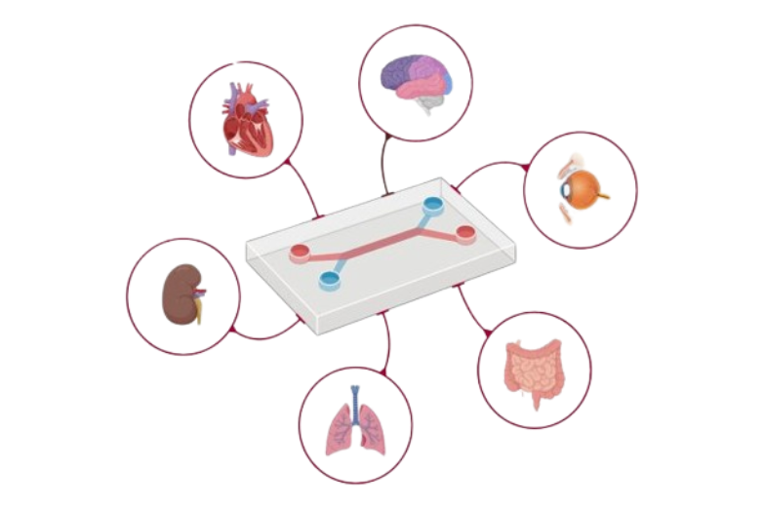
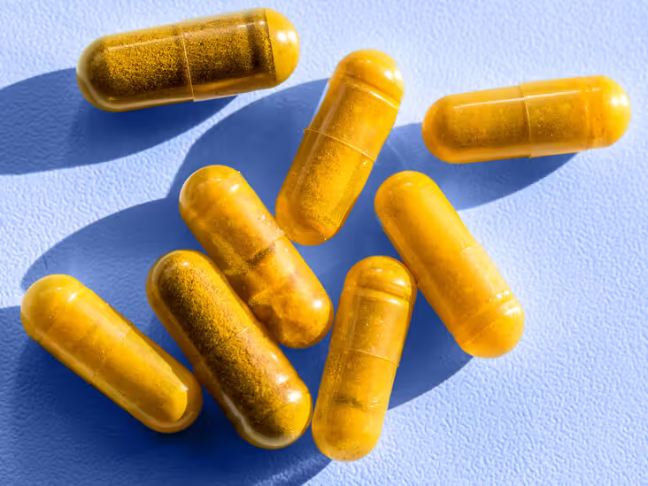
Objective & Research Question
Objective: Develop a TBI-on-a-chip platform replicating the blood brain barrier (BBB) microenvironment after injury
Research Question: Developing a TBI on a chip platform replicating the BBB to study drug testing - curcumin
Notes:
Based on the limitations, curcumin was never tested on human cells from the first cell
The second study didn't really focus on the holistic effect of the blood brain barrier when it goes through secondary injury.
The last study didn’t really do the primary injury properly, because even though the shear stress followed physiological conditions it didn’t really execute the sudden shock in the primary injury.

Slide 15
Device Design and Fabrication
Materials Used:
  Polydimethylsiloxane (PDMS) for casting channels.
  Custom 3D printed mask molds for shaping PDMS.
Channel Specifications:
  Channels were 2 cm long and 1 mm wide.
  Top channel was 1 mm high, bottom channel was 0.2 mm high.
PDMS Casting:
  PDMS parts were cast using a 10:1 ratio of base to curing agent.
  Degassed at -80 kPa to remove bubbles.
  Cured at 60 °C for at least 4 hours.
Inlet and outlet formations
  Biopsy punches of 1 mm made
Membrane Preparation:
  Epoxy silane method used for bonding membranes to PDMS.
  A polyethylene ter-phthalate (PET) membranes with 0.4-μm perpendicular pores
  Parts and membranes treated with O2 plasma and submerged in specific silane solutions for bonding.
  Parts aligned and bonded by hand, then placed in a 60 °C oven under weights for at least 12 hours for annealing.
Notes:
polyethylene terephthalate (PET)

Slide 16
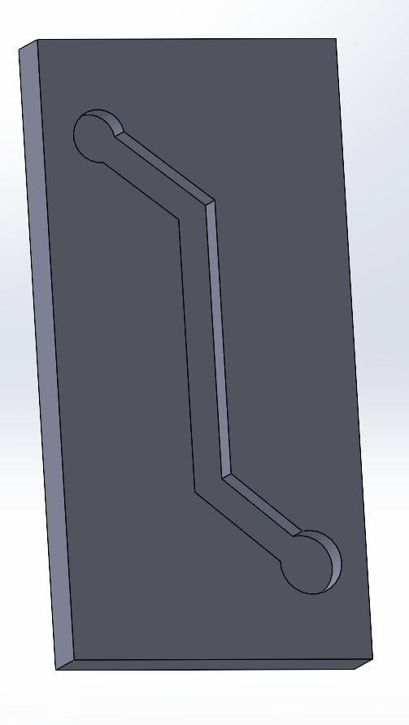
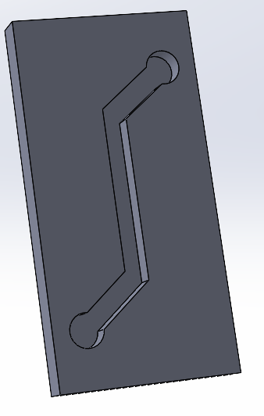
Chip Layers
Top Layer
Containing astrocytes and pericyte network
Bottom Layer
Containing endothelial monolayer

Slide 17
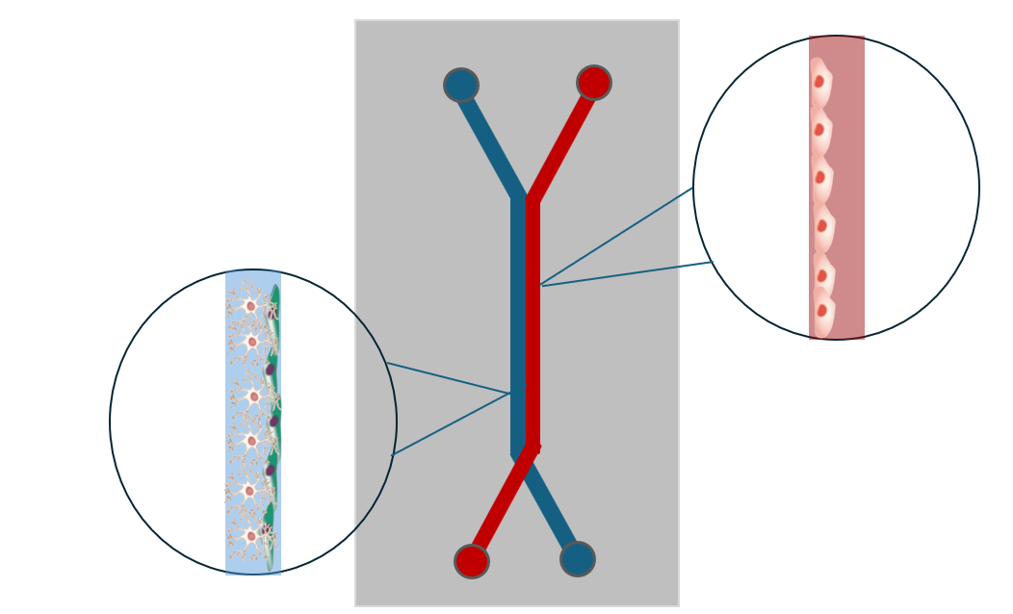
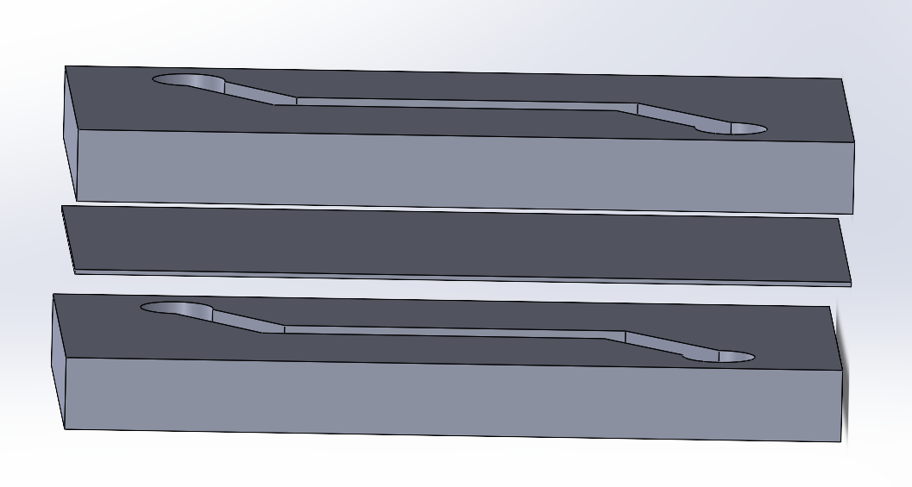
Device Assembly
Side view:
Top and bottom layer connected with porous membrane

Slide 18
Cell Seeding
Microfluidic Device Design:
  The upper channel represents the central nervous system (CNS) microenvironment, while the lower channel represents the vascular system.
  The channels are separated by a porous membrane coated with extracellular matrix (ECM) proteins (collagen type IV and fibronectin).
Cell Seeding and Culture:
  A mixture of primary human brain astrocytes and pericytes, in a ratio of 7:3, were cultured on the upper side of the porous membrane in the upper channel for 1 hour.
  Human induced pluripotent stem cell-derived brain microvascular endothelial cells (iPS-BMVECs) were cultured on the bottom side of the porous membrane in the lower channel.
  Chip was cultured for one additional day to promote endothelial monolayer formation and to acclimate the cells to the device
Adhesion and Monolayer Formation:
  iPS-BMV ECs were allowed to adhere to the membrane by incubating the microfluidic chip upside down for 5 hours.
Flow Control and Shear Stress:
  Flow through the vascular channel was controlled by microfluidic pumps to maintain physiological levels of fluid shear stress (6 dyne cm^-2) and blood-like viscosity (3–4 cP).

Slide 19
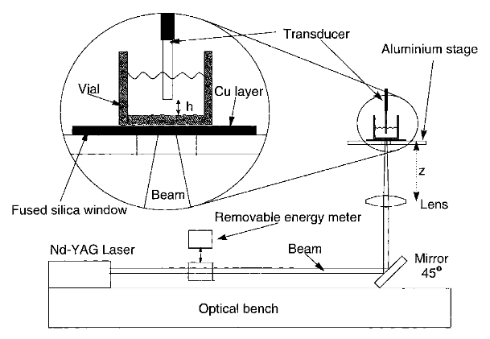
Methods
Physical Injury : Shock wave induced injury
Take the chip and put in a shock chamber
Laser induced shock wave (LIS method)
Shock waves administered in the chamber
https://doi.org/10.1002/(sici)1096-9101(2000)26:4%3C364::aid-lsm4%3E3.0.co;2-t
Notes:
https://www.nature.com/articles/s41598-023-43214-7, https://www.ncbi.nlm.nih.gov/pmc/articles/PMC9152581/ ; https://www.ncbi.nlm.nih.gov/pmc/articles/PMC6202591/
https://www.sciencedirect.com/science/article/abs/pii/S1350453322000182
Make a picture

Slide 20
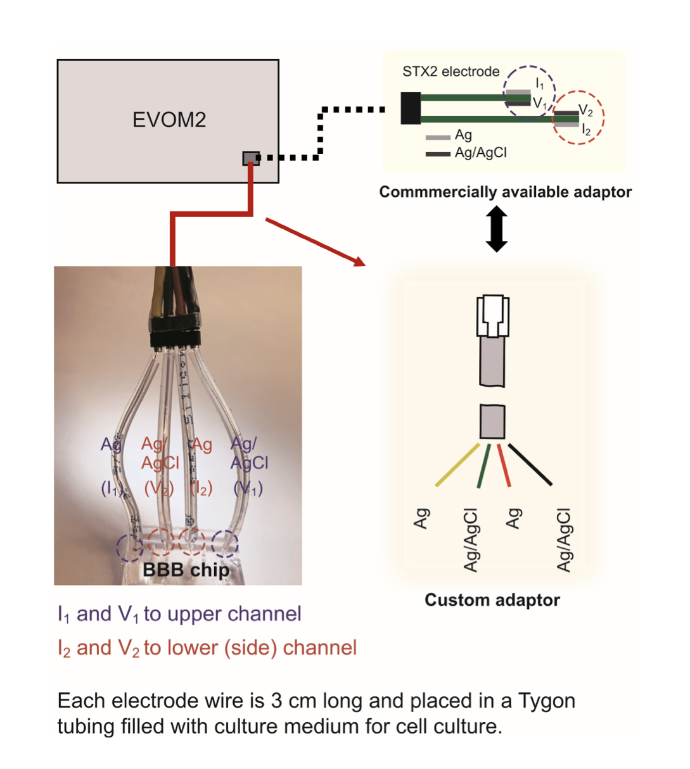
Methods
Teer Measurement
Prepare the Setup:
  The chip should be positioned such that the electrodes of the measurement system are in contact with the medium in both the upper CNS microchannel and the lower vascular microchannel.
Electrical Impedance Measurement:
  Apply a low-frequency alternating current (AC) voltage across the electrodes.
  Measure the resulting current passing through the medium in the microchannels.
  The impedance (Z) of the system can be calculated using Ohm's law: Z = V/I
  The Ag/AgCl electrode integration directly into the platform
3. Calculate TEER:
  TEER is calculated using the formula: TEER = (Z_sample - Z_blank) × Area, where Z_sample is the impedance measured across the cell monolayer, Z_blank is the impedance measured across a blank area of the chip (without cells), and Area is the cross-sectional area of the membrane.
Data Analysis:
  Record the TEER values at different time points..
Notes:
10^-6 to 10^-8 cm/s: per; teer : several hundred to over a thousand ohm·cm^2

Slide 21
Methods
Permeability measurement
Permeability Assay:
500 μg mL−1 FITC-dextran introduced into the lower channe1.
Incubate and collect samples from both upper and lower channels.
Assay Setup:
Use of fluorescence microplate reader or microscope for measurement.
Calculate permeability coefficient using collected data.
P = (dQ/dt) / (A × C0)
Data Analysis:
Assess permeability of endothelial monolayer.
Compare permeability under different conditions.
Notes:
fluorescein isothiocyanate (FITC; P = (dQ/dt) / (A × C0), where dQ/dt is the rate of appearance of the compound in the upper channel, A is the surface area of the membrane, and C0 is the initial concentration of the compound in the lower channel.

Slide 22
Methods
Introduction of secondary injury
Preparing secondary injury factors NLRP3 (1-10 ng/ml), IL-1β, IL-6, IL-18, and TNF-α (1-100 ng/ml)solutions at specific concentrations.
Administering the secondary injury factors into the medium flowing through the lower vascular microchannel of the BBB chip at 22 hours after the introduction of primary injury.
Using a microfluidic pump to control the flow rate and volume of the solution containing the secondary injury factors.
Allowing the secondary injury factors to flow through the BBB chip for 6 hours of incubation period.
Measuring changes in transendothelial electrical resistance (TEER) to assess barrier integrity.
Quantifying the levels of inflammatory cytokines (IL-1β, IL-6, IL-18, TNF-α) using enzyme-linked immunosorbent assay (ELISA)
Notes:
Nucleotide-binding domain, Leucine-rich repeat, Pyrin domain-containing protein 3."

Slide 23
Methods
Administration of Curcumin:
Preparing the curcumin solution in appropriate DMSO solvent to prepare a stock solution at 28 hrs.
Administering Curcumin directly into the medium flowing through the lower vascular microchannel of the BBB chip.
Using a microfluidic pump to control the flow rate and volume of Curcumin solution administered.
Allowing the Curcumin-treated medium to flow through the BBB chip for 5 weeks to ensure exposure of the endothelial monolayer to the compound.
Control treatment : untreated sample of BBB chip to assess the specificity of Curcumin effects and also comparing with previous in vivo studies.
Evaluating gene expression changes using qPCR

Slide 24
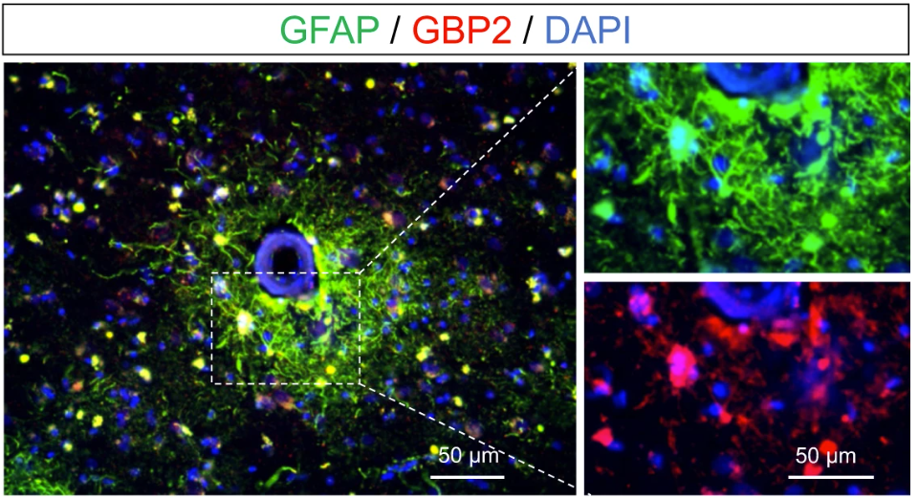
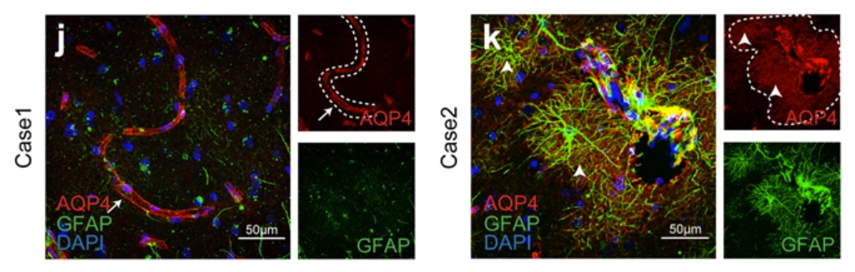
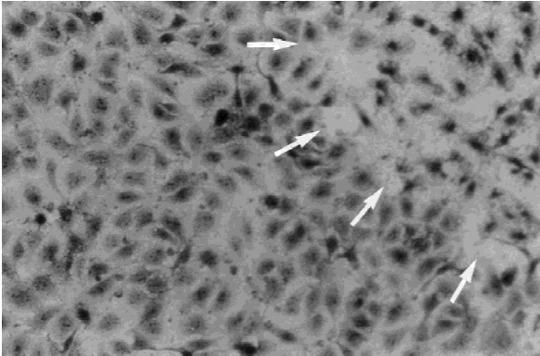
Results Expectation: Modeling TBI
Disruption of BB tight junctions
Upregulation of reactive astrocytes
  GFAP
  GBP2
Upregulation of AQP4
https://doi.org/10.1002/(SICI)1096-9101(2000)26:4<364::AID-LSM4>3.0.CO;2-
https://doi.org/10.1038/s41598-017-02505-6
Notes:
https://www.sciencedirect.com/science/article/pii/S0753332222010101?via%3Dihub, https://www.eurekaselect.com/article/98889, https://www.sciencedirect.com/science/article/pii/S0361923017304173?via%3Dihub

Slide 25

Results Expectation: Curcumin Treatment
Gene expression analysis using qPCR:
A decrease in the expression of pro-inflammatory genes such as IL-1β, IL-6, TNF-α, and COX-2. This downregulation indicates a reduction in neuroinflammation following Curcumin treatment.
An upregulation of anti-inflammatory genes such as IL-10 and TGF-β. This indicates a shift towards an anti-inflammatory environment in response to Curcumin treatment.
Downregulation of oxidative stress-related genes such as Nrf2 and HO-1, indicating a decrease in oxidative damage.
Changes in the expression of genes associated with NF-κB and MAPK signaling pathways, indicating normalization of inflammatory signaling.
Notes:
https://www.sciencedirect.com/science/article/pii/S0753332222010101?via%3Dihub, https://www.eurekaselect.com/article/98889, https://www.sciencedirect.com/science/article/pii/S0361923017304173?via%3Dihub

Slide 26

Research Impact
Currently, no TBI-on-a-chip model which replicates both primary and secondary injury
Introduction of a no-contact physical injury of TBI
No therapeutic for TBI
  Utilizing a natural herbal treatment
Notes:
Advancements / innovation of the device, Shock wave induction, Biochemical insult, Curcumin treatment

Slide 27
Future work
Extending the application of the BBB chip device beyond TBI to study other neurological disorders characterized by BBB dysfunction, such as stroke, Alzheimer's disease, and multiple sclerosis.
Utilizing induced pluripotent stem cells (iPSCs) derived from patient samples to create personalized BBB chip models of TBI. This would allow researchers to study individual variability in drug responses and identify personalized treatment strategies.
Further diversify the cell types present in the BBB chip model to better mimic the complexity of the neurovascular unit.
Overall, the future directions for the BBB chip device for studying TBI are focused on enhancing its physiological relevance, scalability, and predictive value, with the ultimate goal of improving our understanding of TBI pathology and developing effective treatments for patients.

Slide 28
Limitations
Utilizing LIS method may be challenging at a microscale level
  Inducing physical injury such as a violent blow might be difficult to execute on such a small scale and jeopardize device integrity
Maintaining the viability and functionality of cells within the BBB chip model over long-term culture periods may be challenging and could affect the relevance of results for studying chronic aspects of TBI pathology.
The BBB chip model typically relies on static culture conditions, which may not fully mimic the dynamic microenvironment of the brain following TBI, including changes in blood flow, shear stress, and interstitial fluid dynamics.
While the BBB chip model allows for the co-culture of different cell types, it may still lack the full complexity of the neurovascular unit and the surrounding brain tissue.

Slide 29


Educational outreach
Hosting public events, such as science fairs, open houses, or health expos, to showcase the BBB chip model and educate the community about TBI and Curcumin therapy.
Collaborating with schools, medical institutions, and universities to incorporate the BBB chip model into their science curriculum or research projects.
Offering workshops or seminars for students and educators to learn about the BBB chip model, TBI, and Curcumin therapy.
Utilizing social media platforms and online channels to share educational content, updates, and resources related to the BBB chip model and Curcumin therapy.
Engaging with followers, answer questions, and facilitate discussions about TBI research and drug testing.

Slide 30
Summary
The BBB chip model provides a physiologically relevant platform for studying the effects of Curcumin on the neurovascular unit in TBI.
Through the BBB chip model, we can investigate Curcumin's impact on BBB integrity, inflammatory responses, oxidative stress, and neuronal function in a controlled microenvironment.
Understanding how Curcumin modulates BBB function and neuroinflammatory pathways can inform the development of novel treatment strategies for TBI.
Continued investigation into Curcumin's therapeutic potential in TBI, leveraging innovative technologies like the BBB chip model, holds promise for improving outcomes and quality of life for individuals affected by TBI.

Slide 31
Shock Chamber
Chip
Lens for focal point
Laser Beam

